Slide 1
Basic Windows
Controls

Slide 2
The List Box,
CheckedListBox
and
ComboBox
Controls

Slide 3
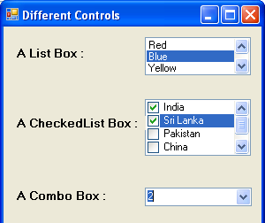
The ListBox, CheckedListBox and ComboBox controls present list of choices from which the user can select one or more.

Slide 4
Differences Among These Controls
The ListBox control occupies a user-specified amount of space on the form and is populated with a list of items. If the list of items is longer than one can fit on the control, a vertical scroll bar appears automatically.
The CheckedListBox control is a variation of a ListBox control. It displays a list of items, like the ListBox control, but also displays a check mark next to items in the list.
The ComboBox control also contains multiple items but typically occupies less space on the screen. The ComboBox control is an expandable ListBox control; the user can expand is to make a selection and collapse it after the selection is made.

Slide 5
Types of Combo Boxes
There are three types of ComboBox control –
DropDown
DropDownList, and,
Simple
Any of these types can be chosen with the help of the DropDownStyle property of the ComBox control.
Value Effect
DropDown (Default) It is a combination of a drop-down list and a text box. An item can be selected from the list or a new one can be typed in the text box.
DropDownList It is a drop-down list. An item can be selected from the list but a new one cannot be typed in the text box.
Simple It is a combination of a list and a text box that does not drop down. An item can be selected from the list or a new one can be typed in the text box.

Slide 6
Common Basic Properties of These Controls
IntegralHeight – This property is a Boolean value (True/False) that indicates whether the control’s height will be adjusted to avoid the partial display of the last item
Items – The Items property is a collection that holds the items on the control. We use the members of the Items collection to access the control’s items and to add or remove items. Each member of the Items collection is an object.
MultiColumn – A ListBox control can display its items in multiple columns, if you set its MultiColumn property to True.
SelectionMode – This property determines whether the user can select multiple items and which method will be used for multiple selections.
Sorted – If you want the items to be always sorted, set the control’s sorted property to True.

Slide 7
The Items Collection
Add – To add items to the list, we use the Items.Add method. The syntax of the Add method is
ListBox1.Items.Add(item)
The Add method appends new items to the end of the list, unless the Sorted property has been set to True.
Insert – To insert an item at a specific location, we use this method, whose syntax is:
ListBox1.Items.Insert(index, item)
where item is the object to be added and index is the location of the new item.
Clear – The Clear method removes all the items from the control. Its syntax is:
ListBox1.Items.Clear
Count – This is the number of items in the list.
ListBox1.Items.Count

Slide 8
Remove – To remove an item from the list, we can use this method, whose syntax is:
ListBox1.Items.Remove(index)
or, ListBox1.Items.Remove(item)
CopyTo – This method retrieves all the items from a ListBox control and stores them to the array passed to the method as argument. Its syntax is:
ListBox1.Items.CopyTo(arr, index)
where arr is the name of the array that will accept the items and index is the index of an element in the array where the first item will be stored.
Contains – This method accepts an object as argument and returns a True/False value indicating whether the collection contains this object or not.
Dim varItem as String
If Not ListBox1.Items.Contains(varItem) Then
ListBox1.Items.Add(varItem)
End If

Slide 9
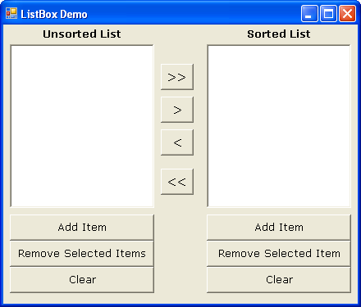

Slide 10
Program:
In the colour code that is used in resistors, the different colours have values as follows:
Black=0, Brown=1, Red=2, Orange=3, Yellow=4, Green=5, Blue=6, Violet=7, Gray=8 and White=9.
The value of the resistor is indicated by drawing three coloured bands round it. The first two bands indicate the first two digits in the numerical value of the resistance, while the third band is the decimal multiplier, i.e., it gives the number of zeroes after the two digits.
For example, if the bands have colours Green-Blue-Orange successively, then the numerical value is 56000.
Design a form with suitable controls and write appropriate event handlers to accept the colours from the user and print the equivalent numerical. Use combo boxes for choosing the various colour options.

Slide 11
The ScrollBar
and
TrackBar
Controls

Slide 12
The ScrollBar & TrackBar Controls
Both these controls let the user specify a magnitude by scrolling a selector between its minimum and maximum values.
The ScrollBar control should be used when the exact value is not as important as the value’s effect on another object or data element.
The Trackbar control has a fixed number of Tick marks, which the developer can label. The user can place the slider’s indicator to the desired value.

Slide 13
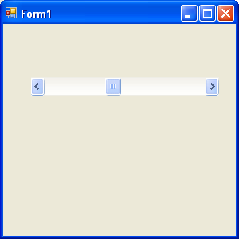
Note: The Minimum and Maximum properties are positive Integer values. If the range we need is 2.5 to 8.5, we can set the Minimum property to 25 and the Maximum property to 85, and then divide the control’s value by 10.
SmallChange
Value
SmallChange
LargeChange
The Basic Properties of a ScrollBar control are:
Minimum – The control’s minimum value (Default value is 0)
Maximum - The control’s maximum value (Default value is 100)
Value - The control’s current value, specified by the indicator’s position.
SmallChange – The amount by which the scroll box position changes when the user clicks a scroll arrow or presses an arrow key.
LargeChange – The amount by which the scroll box position changes when the user clicks in the scroll bar or presses the Page Up or Page Down key.

Slide 14
Changing the Value of a ScrollBar Control
The user can change the ScrollBar control’s value in three ways:
By clicking the two arrows at its ends
By clicking the area between the indicator and the arrows
By dragging the indicator with the mouse
You can monitor the changes on the scrollBar’s value from within your code with two events: ValueChanged and Scroll. Both the events are fired every time the indicator’s position is changed.
If you change the control’s value from within your code, then only the ValueChanged event will be fired.
The Scroll event can be fired in response to many different actions, such as scrolling of the indicator with the mouse or a click on one of the two buttons at the ends of the scrollbars.

Slide 15
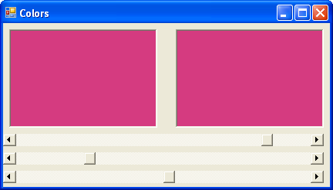

Slide 16
Program:
Using functions, write a program to calculate the simple interest accured on a given principal using the formula:
SI = (Principal x rate x Time) / 100
The user input and output thereof must be on different forms. The input form must have a textbox where the principal must be entered by the user, a scroll bar for the rate of interest, and a listbox from where the user can select the time (in years). Provision must also be kept for adding and removing items to and from the listbox.
On clicking a button, the function must calculate the SI and the result should be shown in the second form.

Slide 17
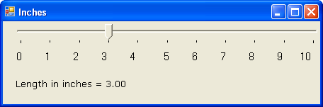
The TrackBar Control
The Basic Properties of a TrackBar control are:
Minimum – The control’s minimum value (Default value is 0)
Maximum – The control’s maximum value (Default value is 100)
Value – The control’s current value, specified by the indicator’s position.
SmallChange – The number of positions the slider moves in response to keyboard input.
LargeChange - The number of positions the slider moves in response to mouse clicks or the PAGE UP and PAGE DOWN keys.
TickFrequency –The number of positions between the tick marks.

